Slide 1
BLU Portal User Guide

Slide 2
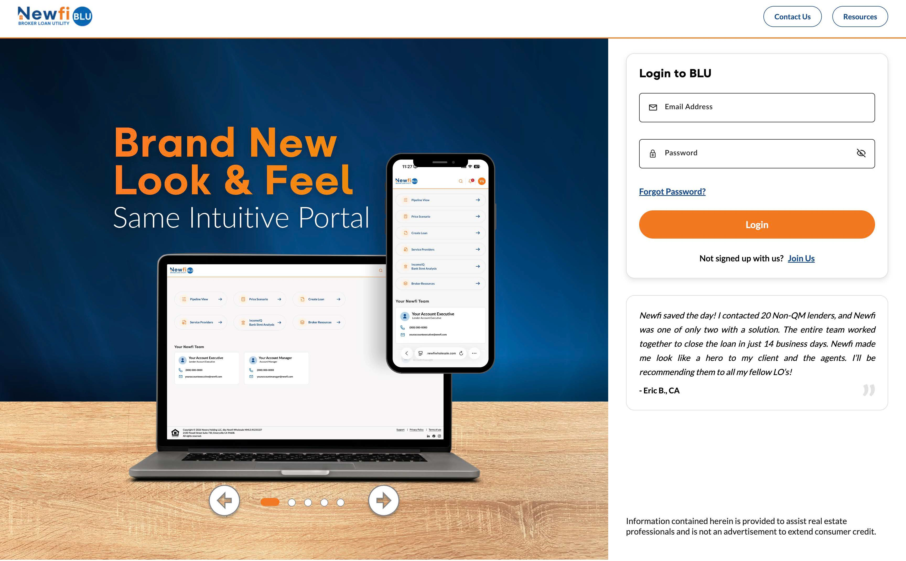
Login Screen
Visit http://www.newfiwholesale.com/ and click “Login to BLU” on the top right corner of the webpage
Enter in your credentials
If you need assistance with your credentials, please contact portaladmin@newfi.com

Slide 3
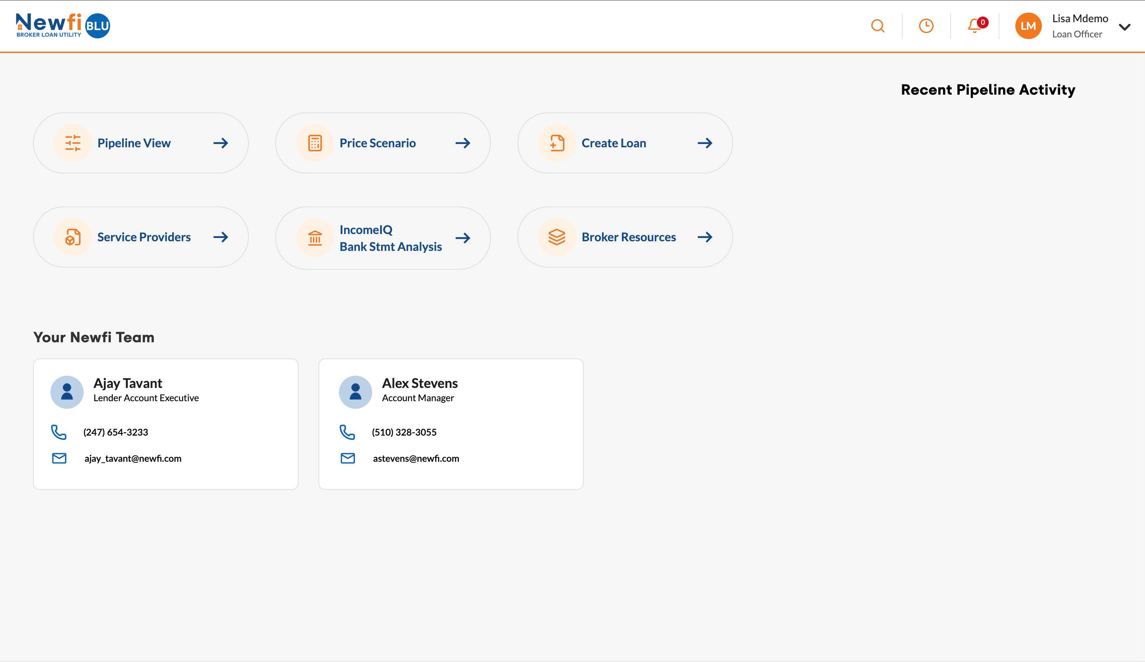
Home Screen
Service Provider – View and sort your active pipeline (view lock status, expiration, etc.)
Price A Scenario – Key in loan attributes to run pricing and eligibility.
Create Loan – Upload 3.4 file and register loan. Service Provider - Saved Providers for ILE lncomelQ Bank Stmt Analysis - Submit Bank Statements for deposit Analysis
Resources – Link to Newfi Wholesale’s resources page for forms, disclosures, and other information.

Slide 4
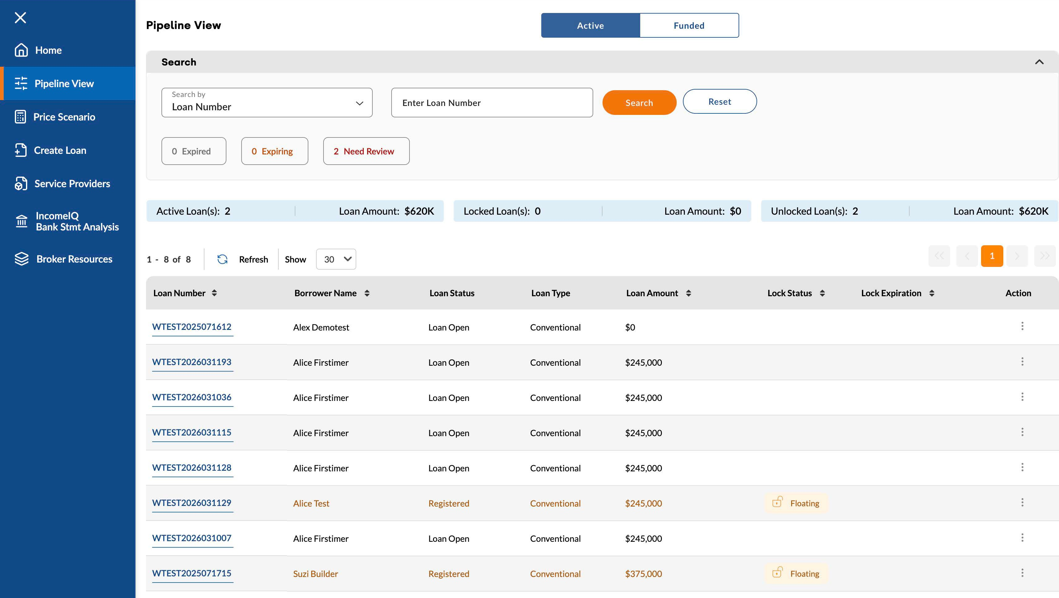
Pipeline View
View and sort active loans by loan number, borrower name, loan amount lock status, and lock expiration.
Click on the loan number to enter the loan.
Click the funded loans to see older loans in your pipeline.

Slide 5
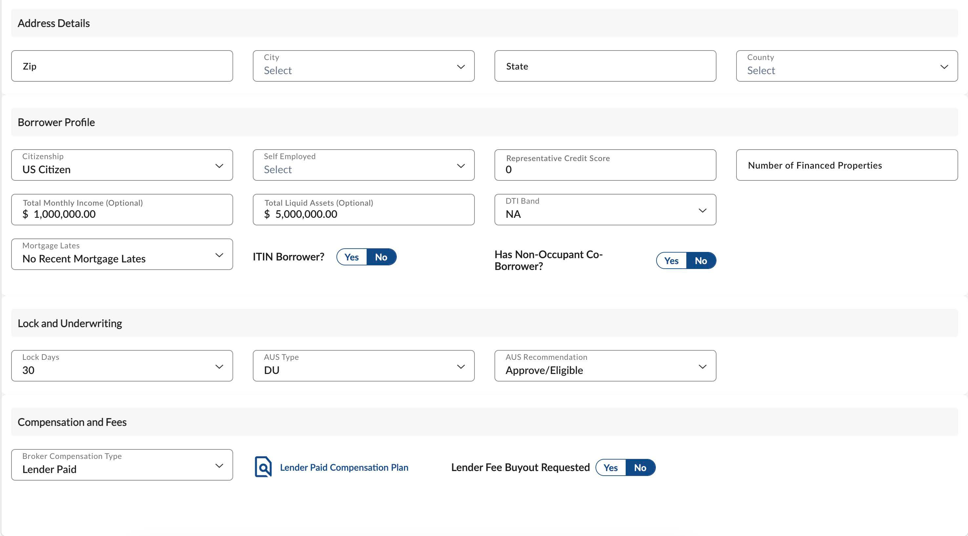
Price Scenario
Key in your Loan Attributes to run pricing and eligibility.
Choose between Lender Paid Comp and Borrower Paid Comp.

Slide 6
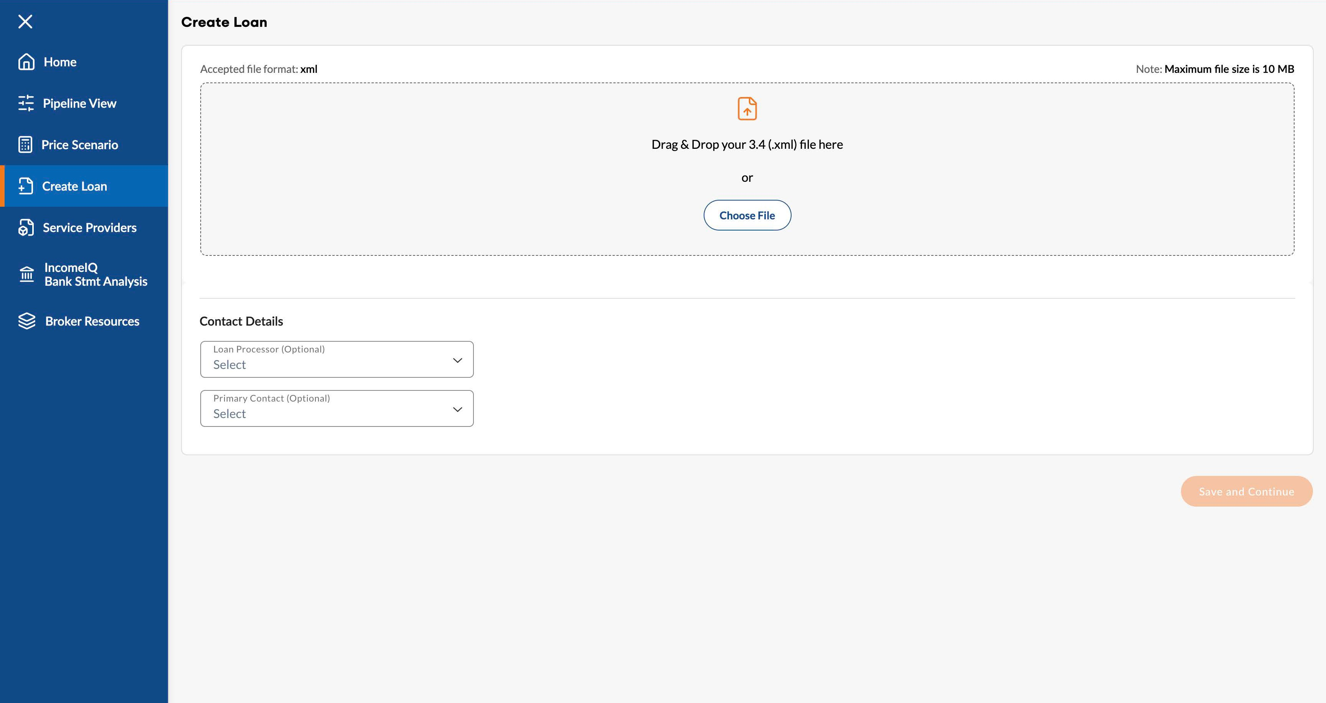
Create Loan
Select an exported FNMA 3.4 file from your LOS to upload.
Choose the assigned Loan Officer from the drop-down menu.
Depending on your role, from the drop-down menu choose either the Processor or LO
The Primary Contact Person can be someone other than LO. Ex. Sales Manager or Processing Manager. This person will be main contact for questions and updates regarding the loan.
Click Save and Continue.

Slide 7
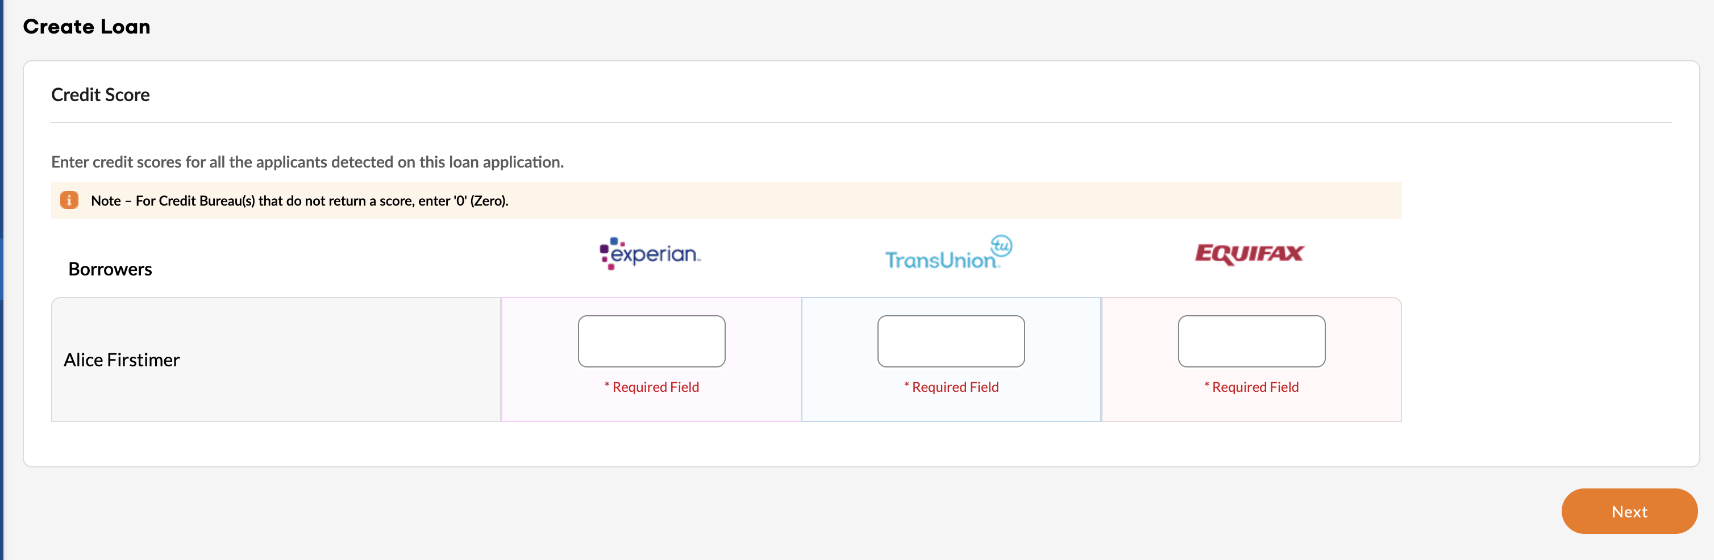
Create Loan
Credit Scores
Enter in the borrower’s credit scores, then click next

Slide 8
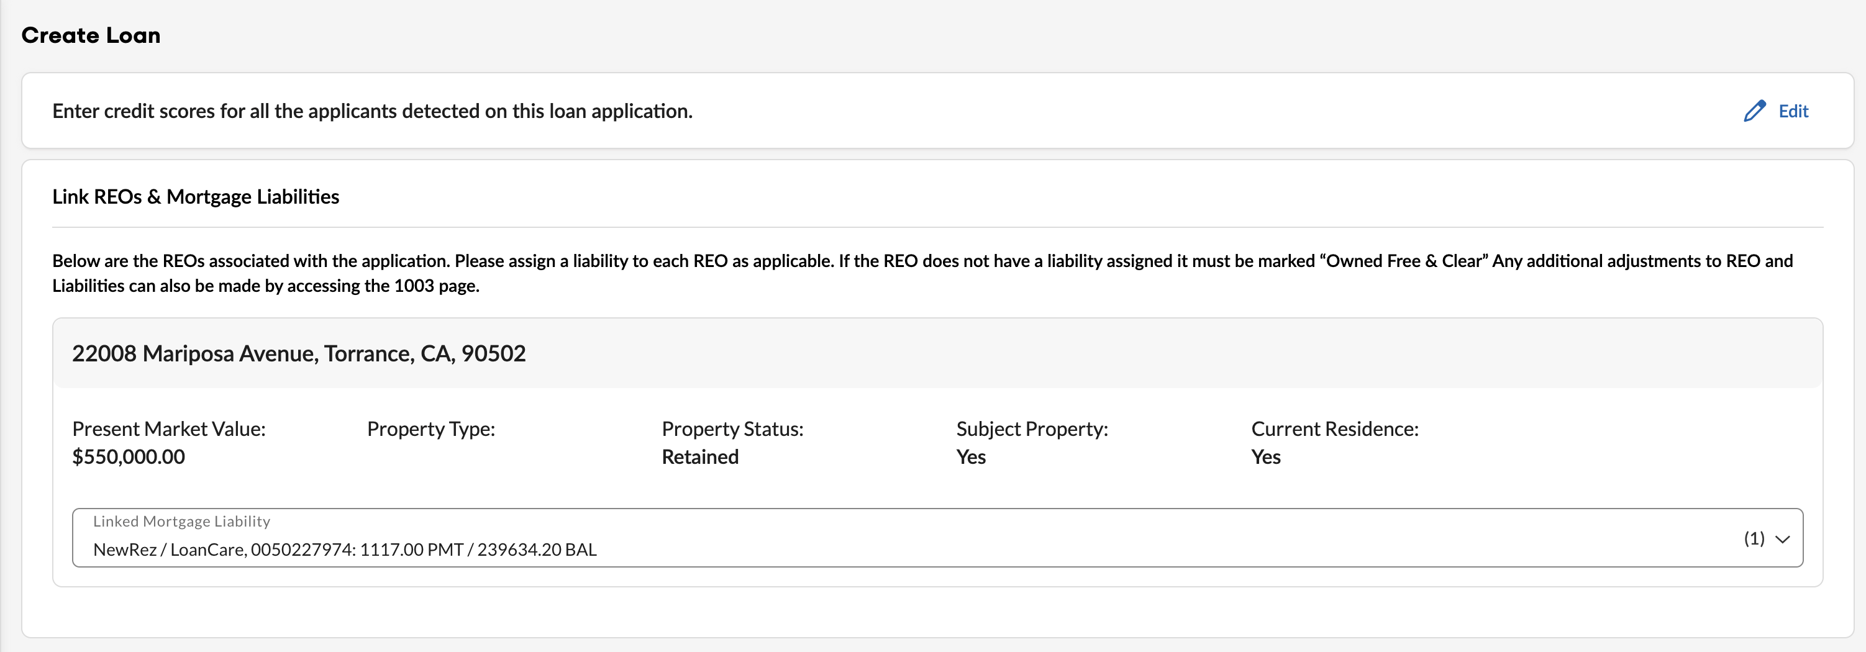
Create Loan
REO & Liability Linking
Link liabilities before importing 3.4 MISMO file.
If there is an existing liability that was not included in the 3.4 MISMO file, the user has the option to reimport an updated 3.4 file or add the liability manually after the loan is created using the 1003 screen in BLU.
If property is owned free and clear select from the dropdown.

Slide 9
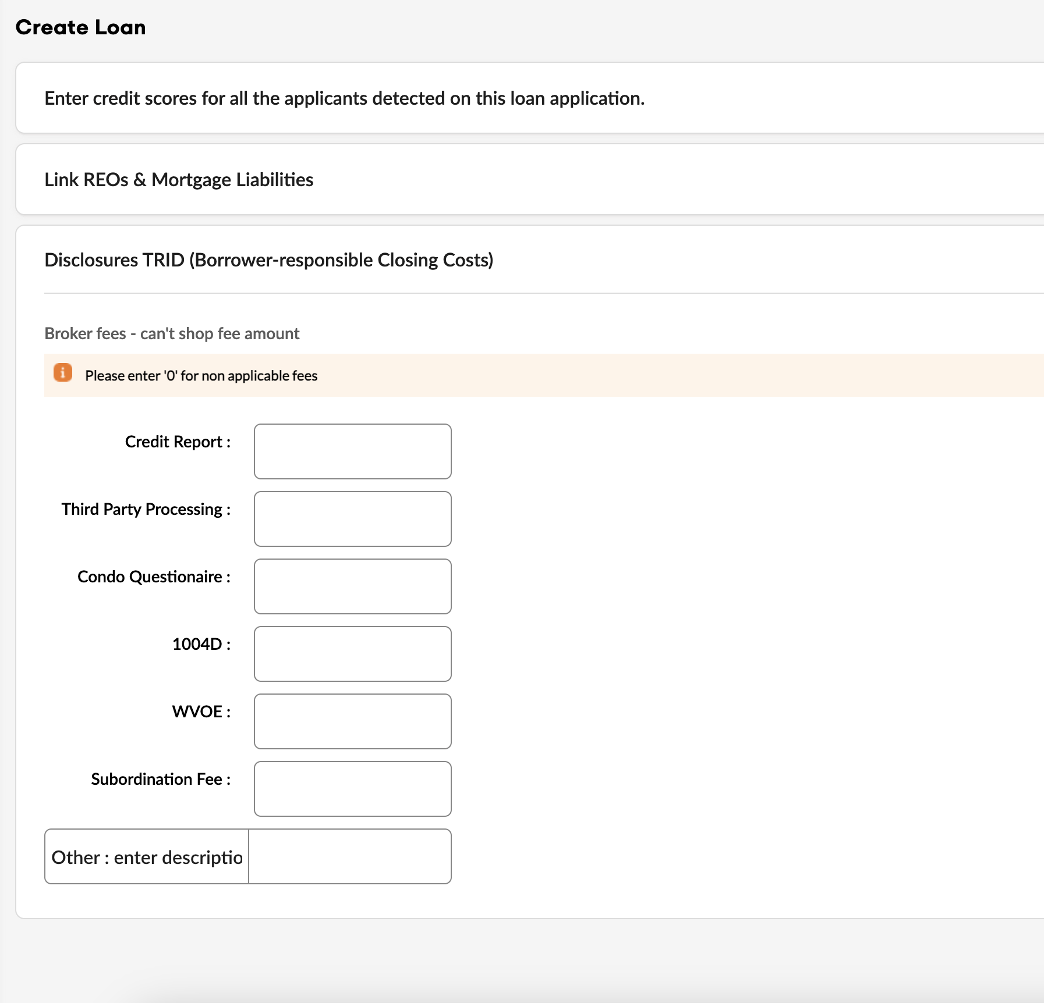
Create Loan
Borrower Shop Fees
Key in the fees as applicable. If the fee doesn’t apply you must enter in 0 (zero).
If there is a fee that is not listed but it does apply, key in the fee description and then key in the fee amount in the
Click next.

Slide 10
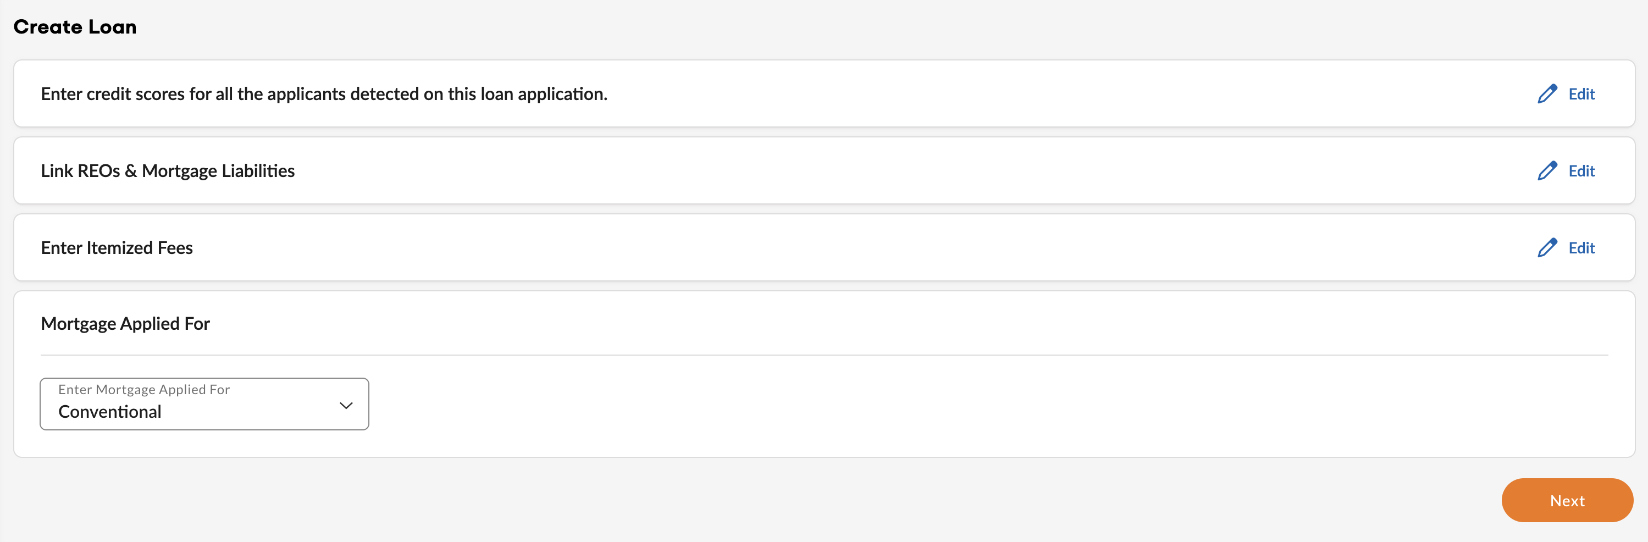


Create Loan
Mortgage Applied For
Mortgage Applied For will default to Conventional for all program options.
Select Edit to return to previous page
Select Next

Slide 11
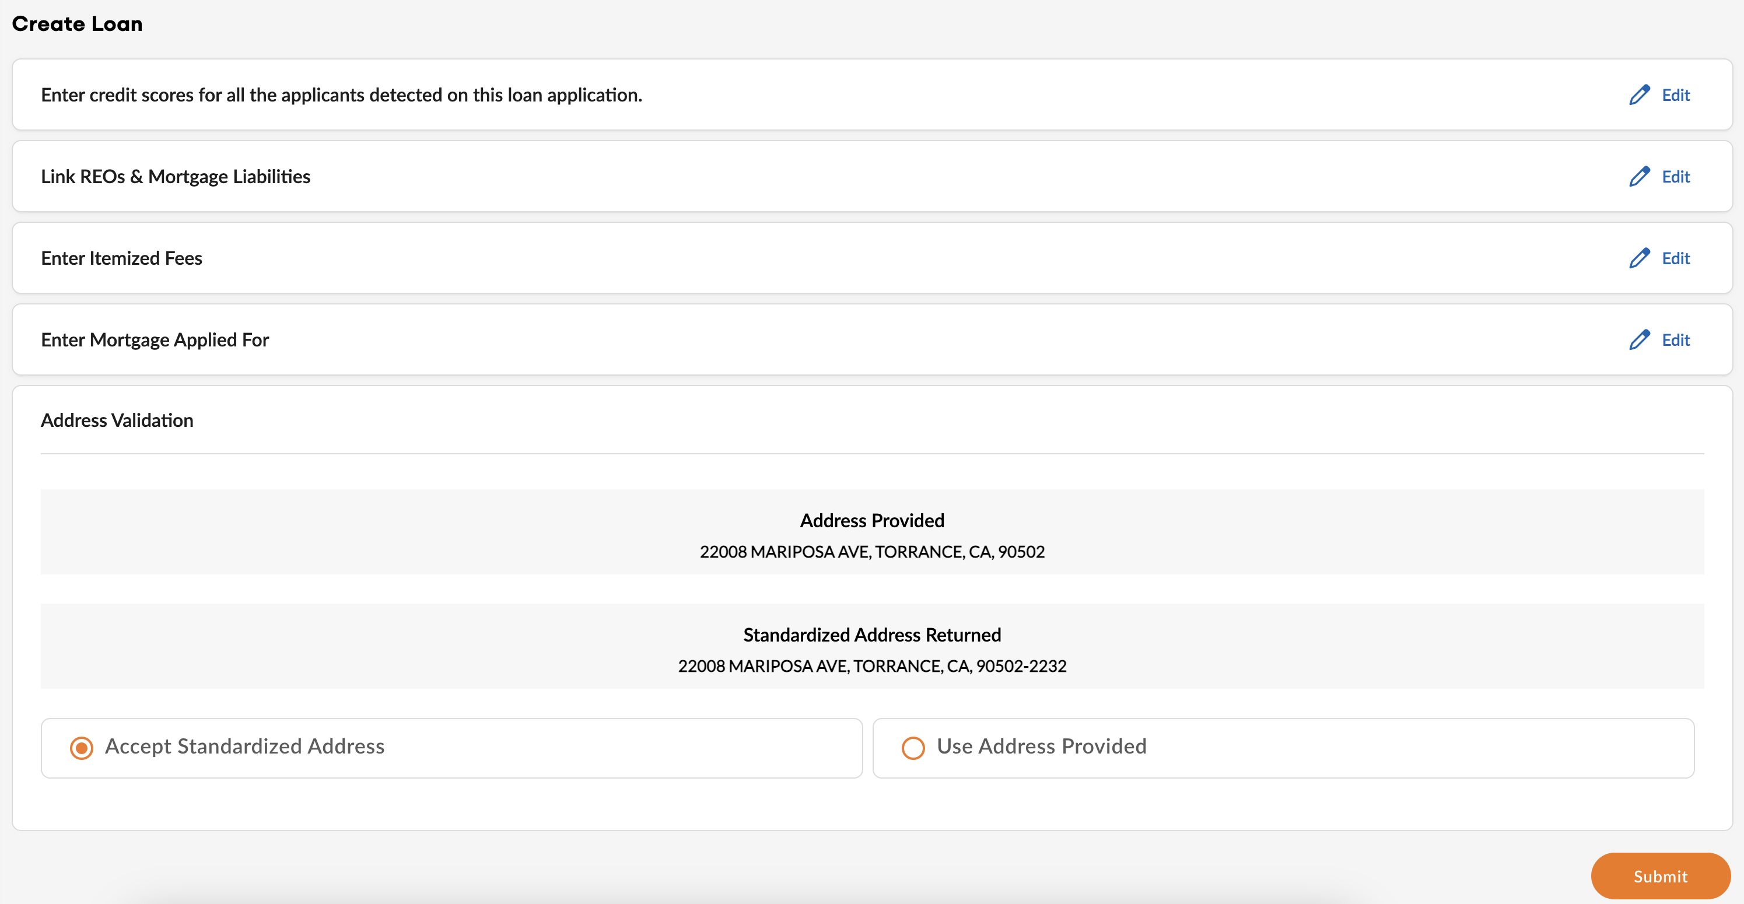
Create Loan
Address Validation
BLU will cross-check the subject property address with USPS records and, if applicable, provide the USPS-standardized format.
The user may either accept the standardized address or proceed with the originally provided address.
Select Edit to make changes on preceding screens.
Click Submit.

Slide 12
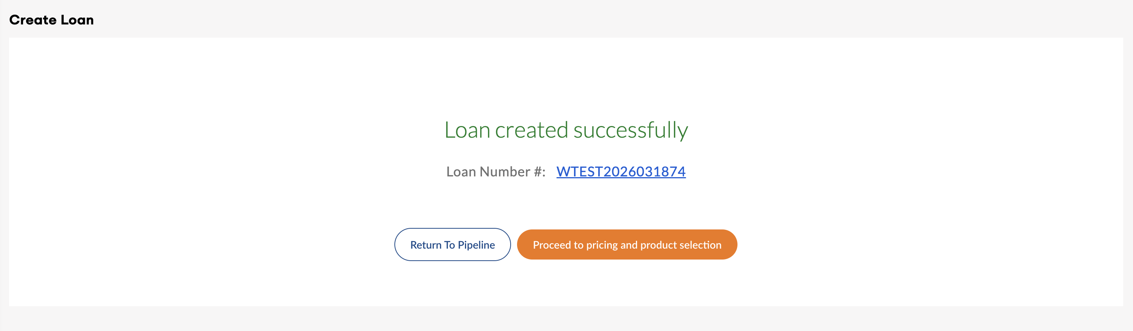
Create Loan
Confirmation
Once the loan number is issued, proceed to select pricing and product selection.
Blu will automatically navigate to the Price Scenario tab.

Slide 13
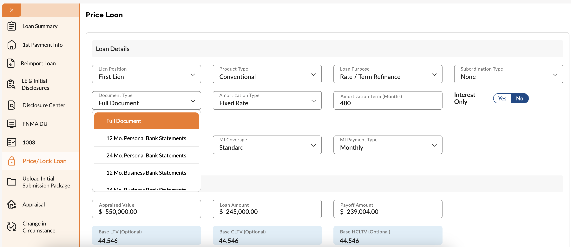
Create Loan
Product and Pricing Selection-
Loan information will be pre-populated onto the screen.
Review and update any information.
Click in the box to activate dropdown.
Select requested doc type

Slide 14
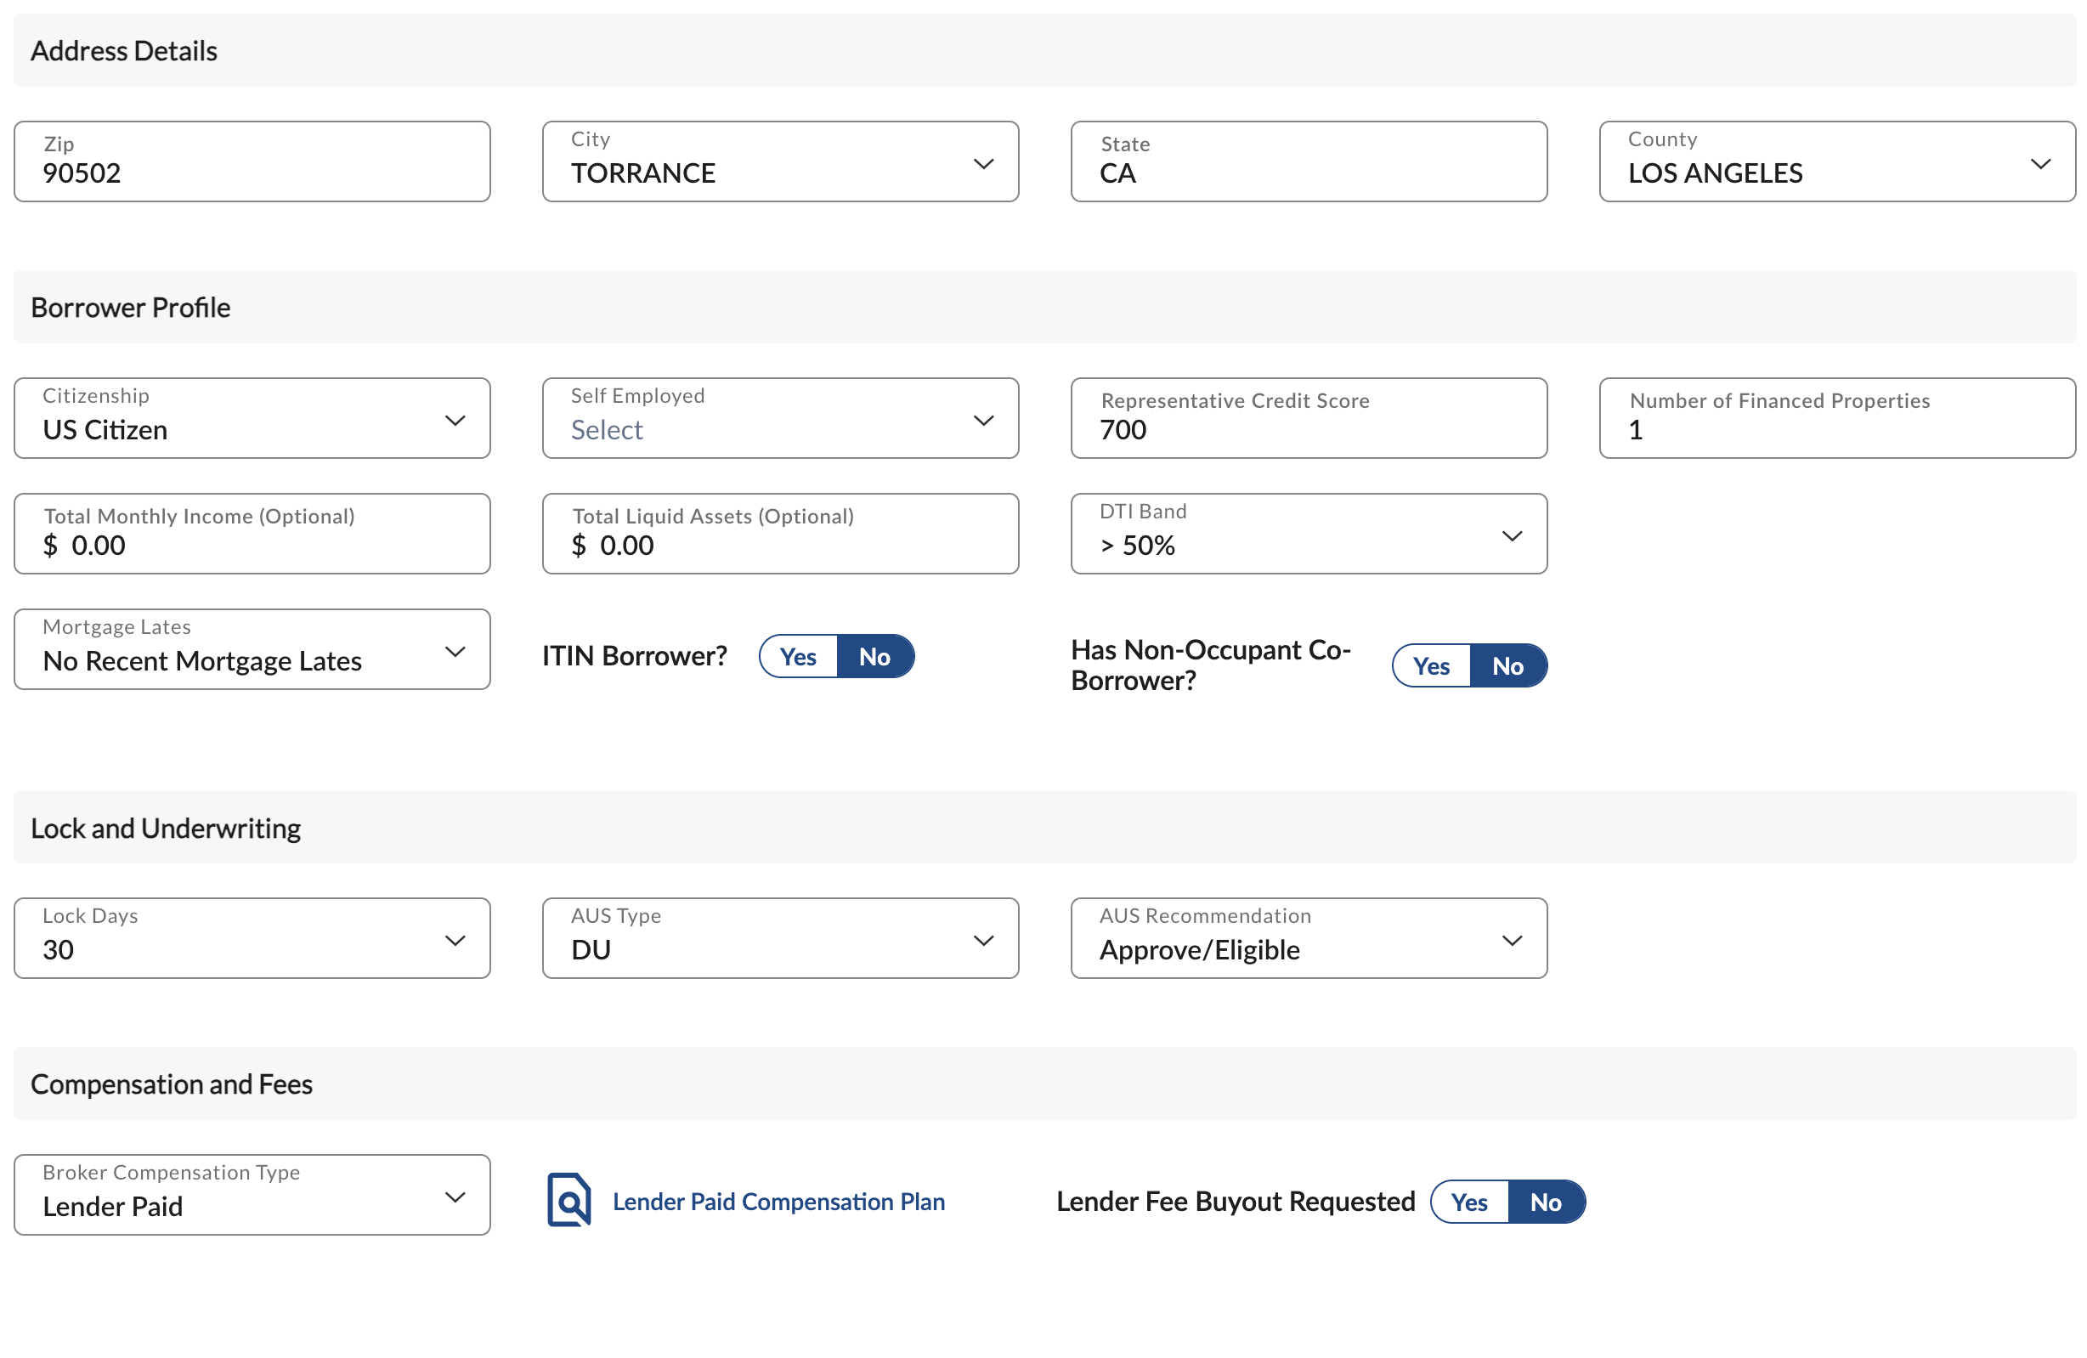
Create Loan
Product and Pricing Selection-
Click in the box for dropdown options.
Select Self Employed Yes or No.
Select LPC or BPC
Clicking on the Lender Paid Comp will verify existing
Select LPC or BPC
Clicking on Lender Paid Comp will verify existing

Slide 15
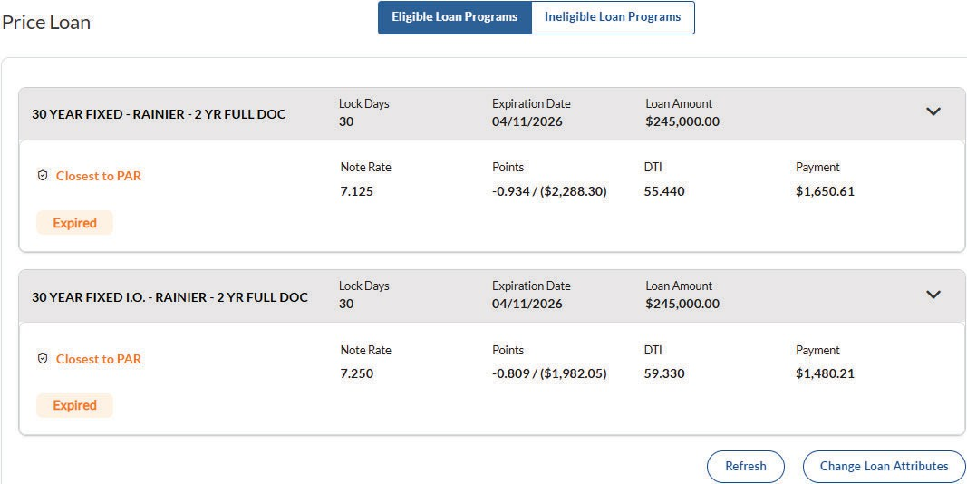
Create Loan
Pricing Results-Eligible
BLU will return results based on program eligibility highlighted in Green.
Eligible programs will be sorted by program and closest par pricing.
When pricing after hours or during a reprice, results will render expired price. Wait and Retry.
Click the down arrow for the program desired for pricing spread.

Slide 16
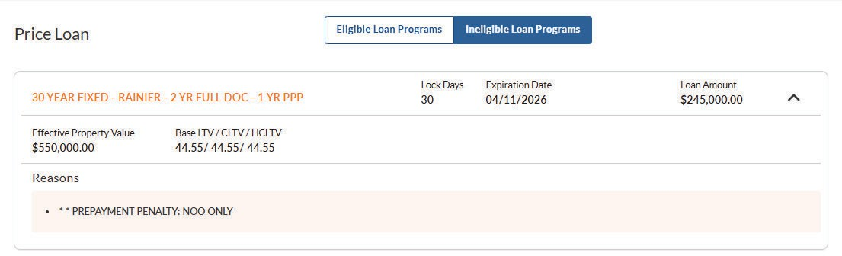
Create Loan
Pricing Results - Ineligible
If the product desired was not displayed, check under “Ineligible Loan Programs” for the desired product which will outline the reason why it didn’t meet eligibility.

Slide 17
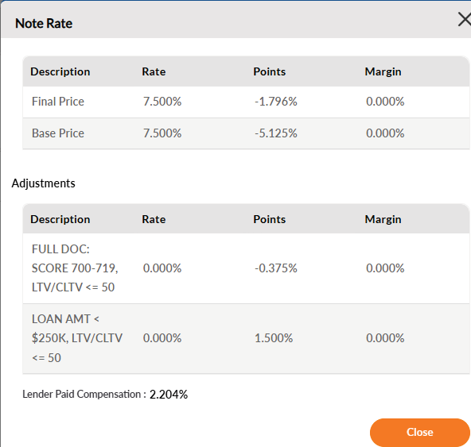
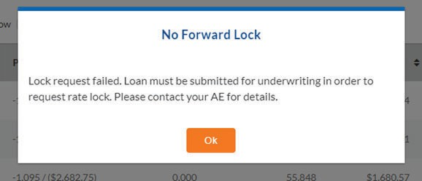
Create Loan
Register Loan
Clicking on the rate will display all the LLPA’s for the chosen product.
Loan may not be locked at time of registration.

Slide 18
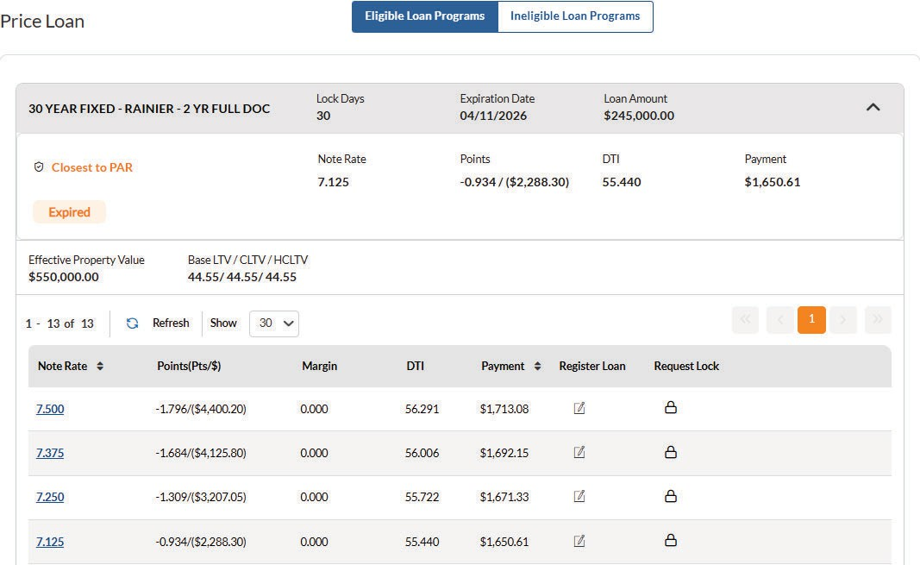

Create Loan
Register Loan
Click on the loan program name to display all pricing options for that program.
If Lender Paid Compensation is selected, pricing will be displayed with compensation included in the price.
Click the radio button next to the desired
rate and then choose “Register”.
Confirmation message will display that the loan has been successfully registered.

Slide 19
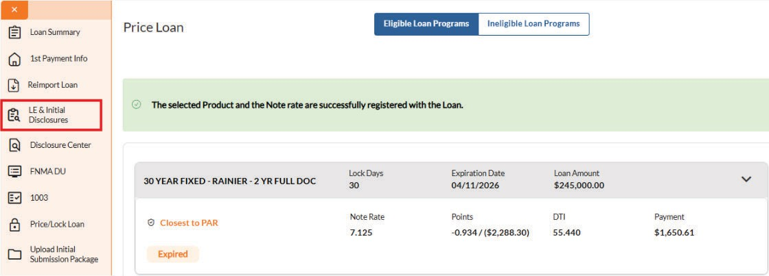
lnstantLE
Create Loan
Clicking on LE & Initial Disclosures to proceed to ILE.

Slide 20

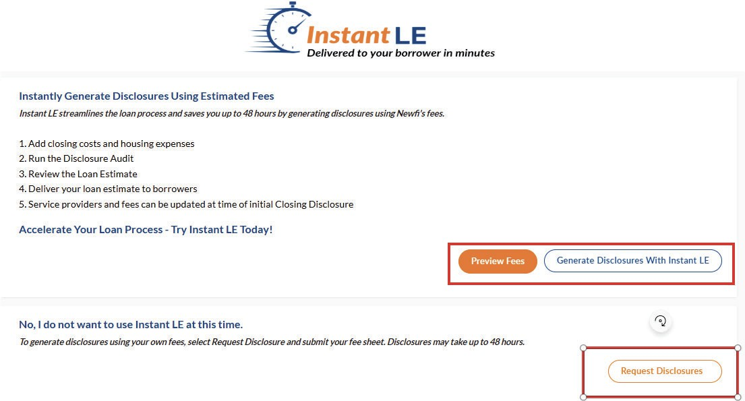
Create Loan
lnstantLE
Generate Disclosures with InstantLE – View default fees by selecting Preview Fees
Request Disclosures – To generate disclosures using Brokers’ own fees.
Click Generate Disclosures with ILE to Begin process.
Fees maybe increased if needed.

Slide 21
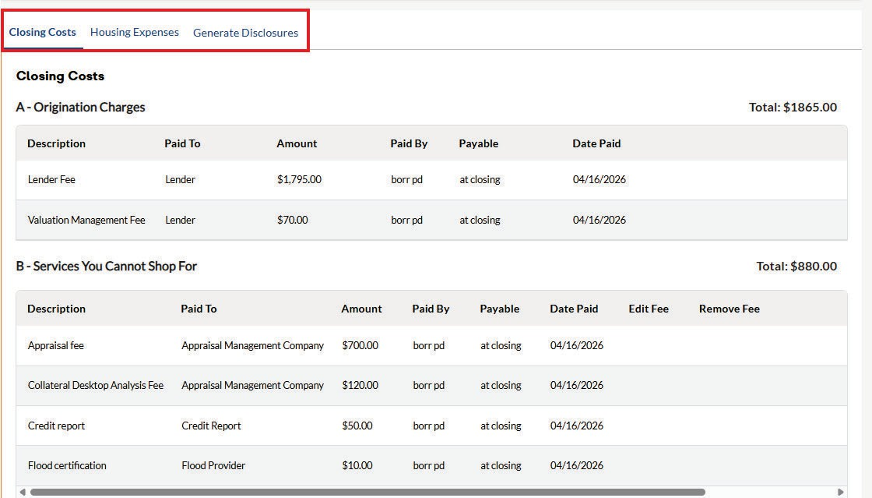
Create Loan
lnstantLE
Review fees in Closing Costs, Housing Expenses, and Generate Disclosures

Slide 22
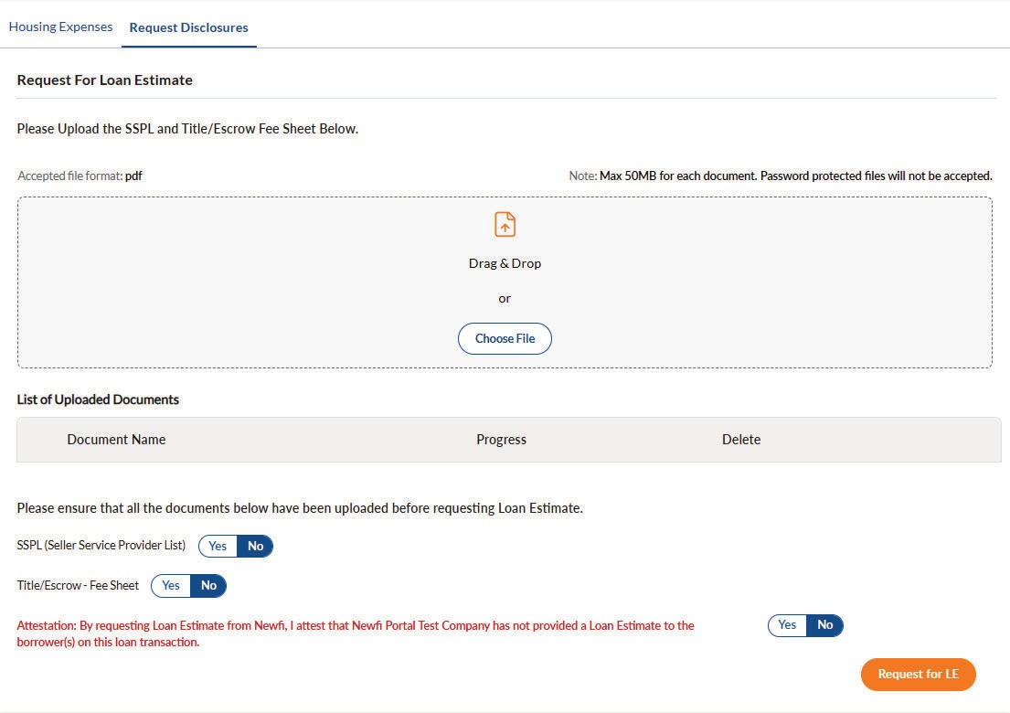
Create Loan
Create LE & Initial Disclosures
If opting out of or file not
eligible for ILE upload the following:
SSPL (Settlement Service Provider List & Title/Escrow Fee Sheet)
Drag and drop documents or browse for them by clicking “Choose File”
Proceed to clicking "yes" to each radio button for each document and attestation

Slide 23
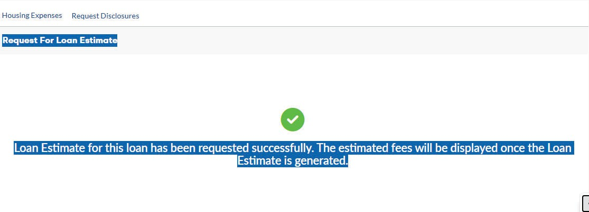
LE Confirmation
Create Loan

Slide 24
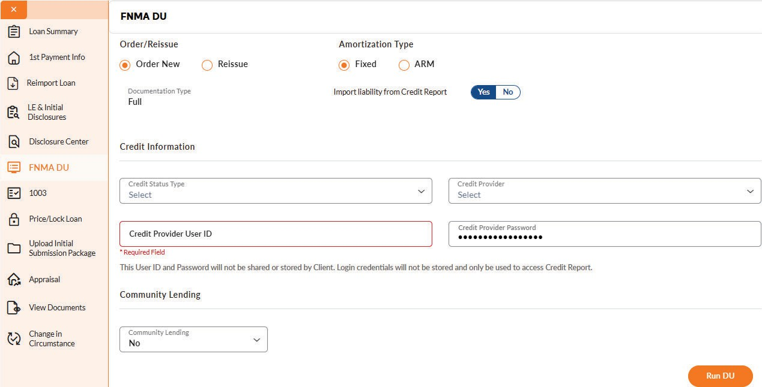
FNMA AUS (Automated Underwriting System)
BLU offers users the ability to run FNMA DU as a new order (in the name of Newfi) or reissue an existing DU that has previously been released to Newfi.
If ordering a new DU report, users will be required to key in their credit report vendor username and password.
Select the appropriate option, complete the credential fields, and then click “Run DU”.

Slide 25
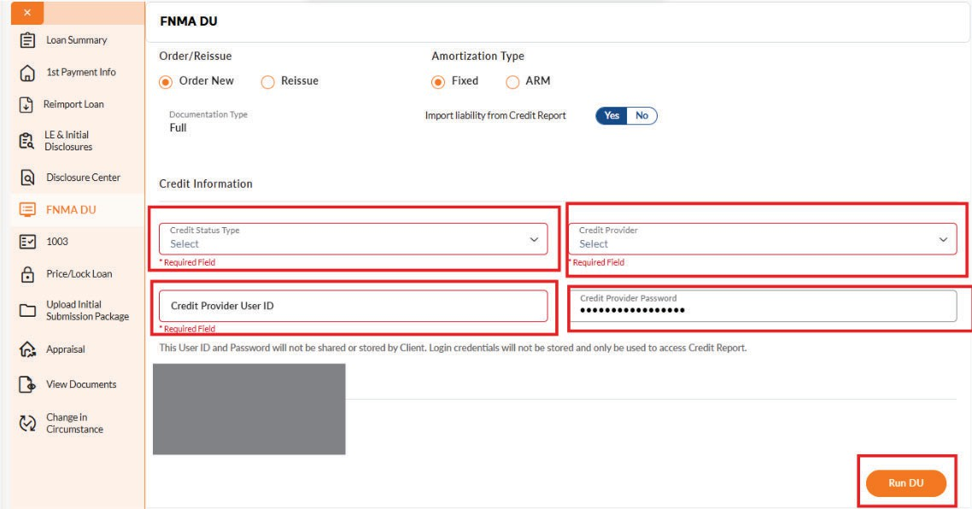
FNMA AUS (Automated Underwriting System)
Findings report will return in a PDF for users to view eligibility.
Upload findings with full file submission.
If running the AUS on our site, it must be completed before full file is uploaded.

Slide 26
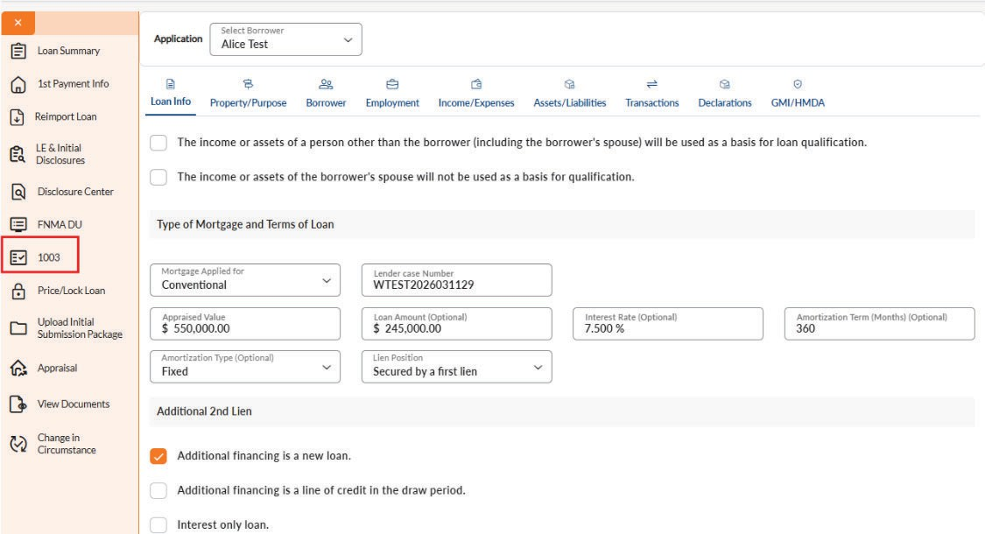
1003
User can edit 1003 application until the loan status reaches “Document Check”
Once the credit package has been received user cannot make further edits.
Navigate the 1003 by selecting the corresponding category from the top of the screen.
For multiple applications, select the appropriate borrower from the Application drop down menu.

Slide 27
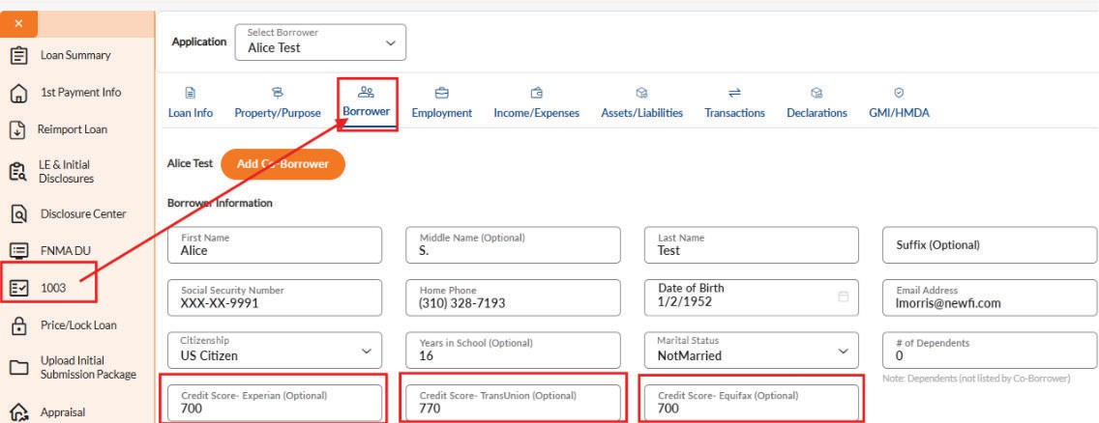
Inputting Scores Manually
Click on the 1003 link in the menu options.
Once in the application screen, select the Borrower tab.
Key in each score for all borrowers on the loan.
Click save at the bottom of the page.

Slide 28
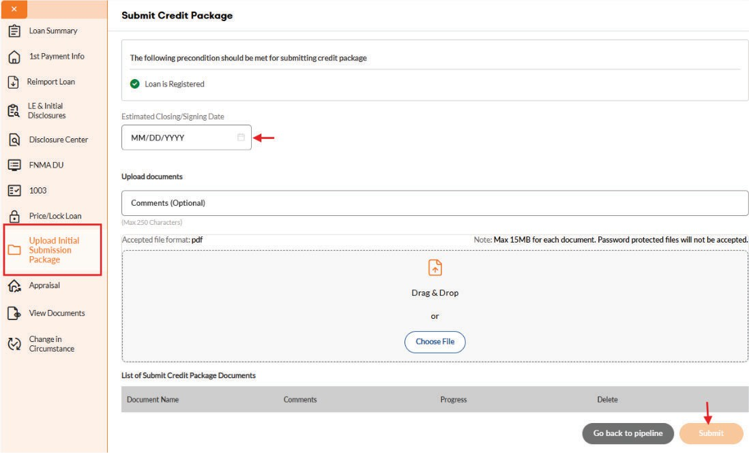
Upload Initial Submission Package
In order to submit the credit package, the LE & Initial Disclosures must have previously been requested, and the loan must be registered
Select the estimated closing date. This date cannot fall on a non-business day, lock expiration date, or during the rescission period based on the lock expiration date (if applicable).

Slide 29
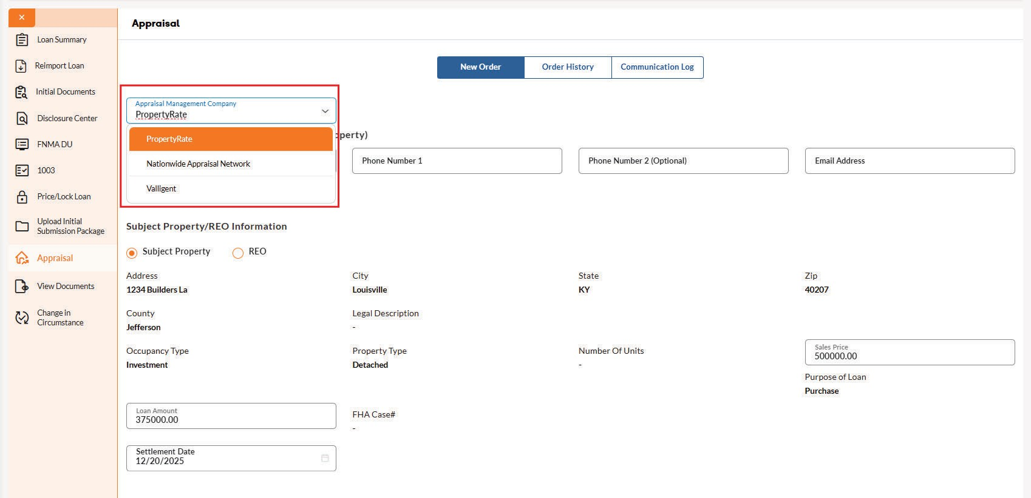
Appraisal Ordering
Select Appraisal of choice from the dropdown.
Property Rate
Nationwide Appraisal Network
Valligent
Key in Date Needed, Report Type by choosing the drop-down arrow and if a rush is needed.
Payment link will be sent to the Loan Officer and Processor within an hour during business hours.
If the loan is a purchase, upload documents such as the purchase contract and prelim by clicking the “yes” radio button.
Click submit to complete the ordering process.

Slide 30
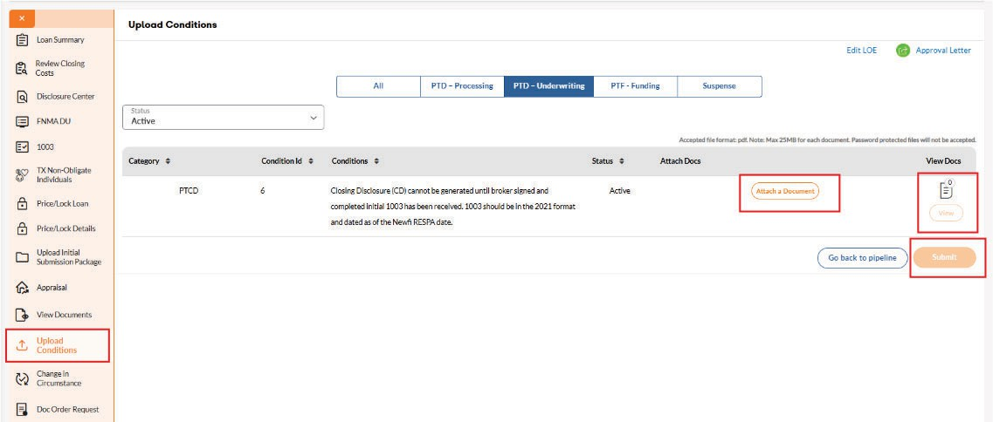
Procedure for Uploading Conditions
Select “Upload Conditions” Tab
Drag and drop your documents into the corresponding condition bucket.
The view icon next to each condition will display the number of documents waiting to be uploaded.
If an erroneous doc is uploaded, you may select view doc to remove.
Select “Save” at the bottom of the page to submit the condition in the file.
Failure to select “Save” will result in the document not being submitted.

Slide 31
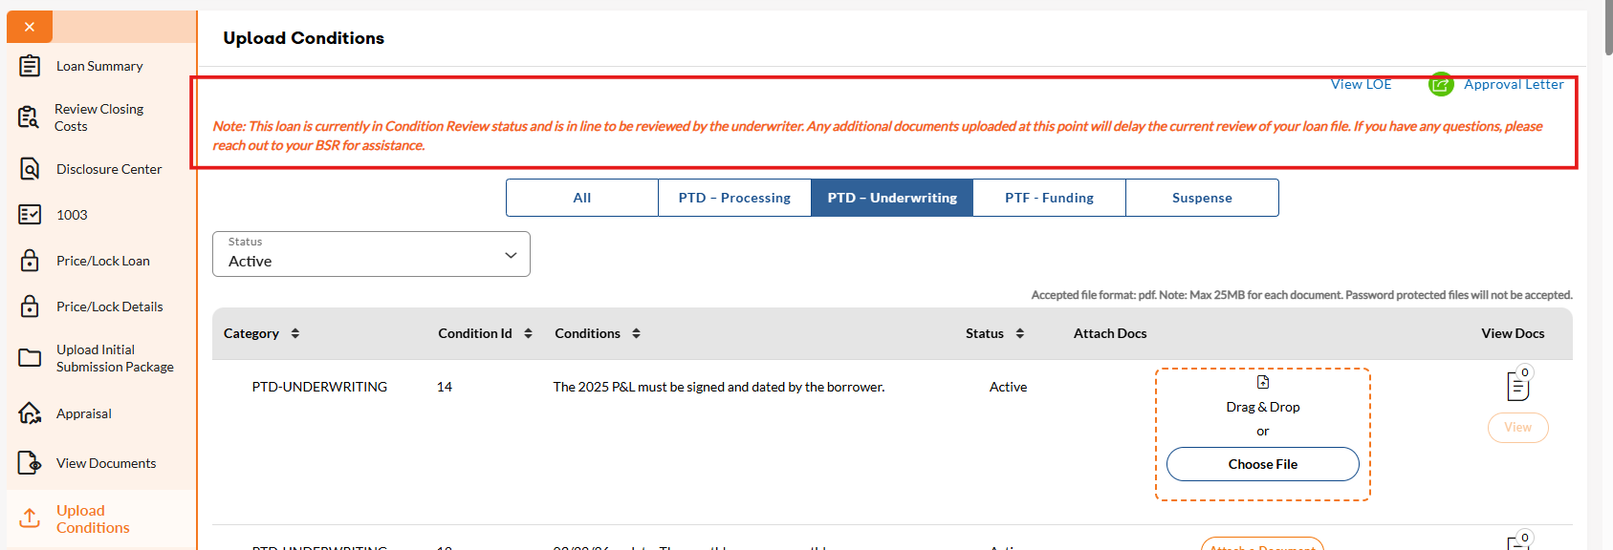
Procedure for Uploading Conditions
If an additional document is attempted to be loaded into a condition that already has a document attached, you will receive the following notice.
"This loan is currently in Condition Review status and is in line to be reviewed by the underwriter. Any additional documents uploaded at this point will delay the current review of your loan file. If you have any questions, please contact your Account Manager for assistance."

Slide 32
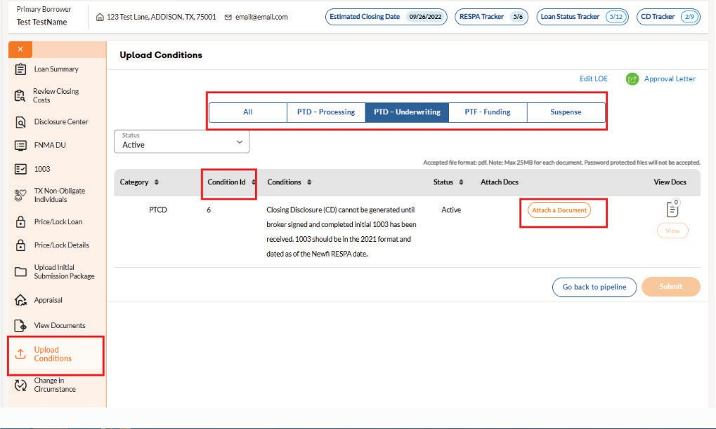
Conditions Management
Conditions screen becomes available once initial underwriter is complete.
Users can attach documents to the specific condition.
Users can sort outstanding conditions by type (i.e., PTD/ PTF).
User can sort by conditions outstanding or closed.

Slide 33
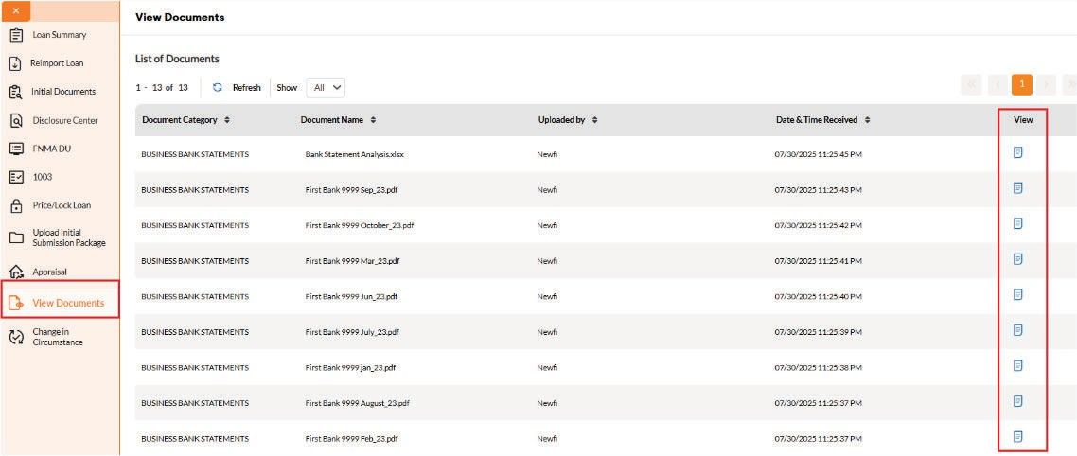
View Documents
Users can view the following documents by clicking the “View Documents” tab: Initial credit file upload.
Any document uploaded by the user.
Appraisal documents.
Disclosures and re disclosures.
Select document icon in the corresponding row to view the file as a PDF.

Slide 34
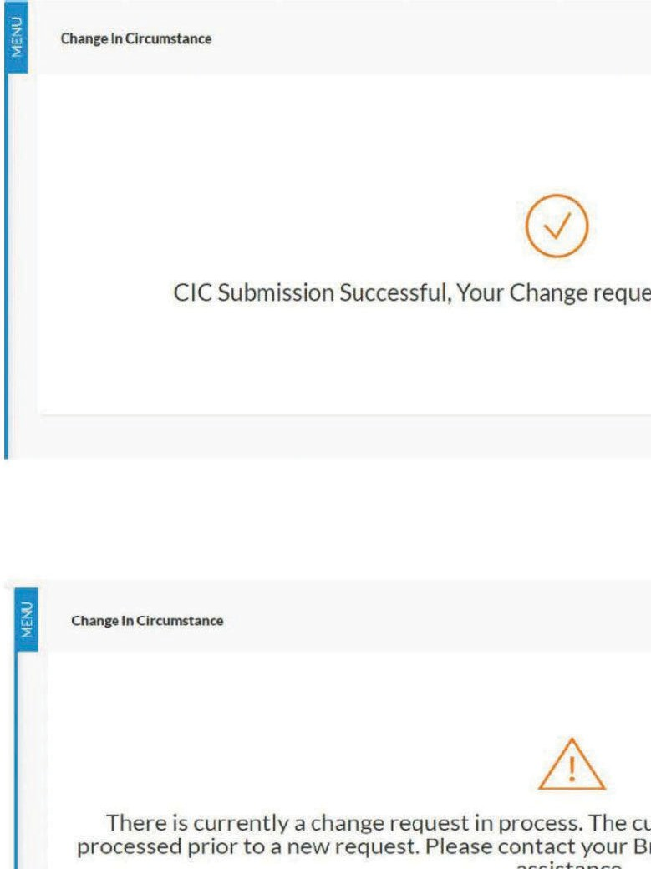
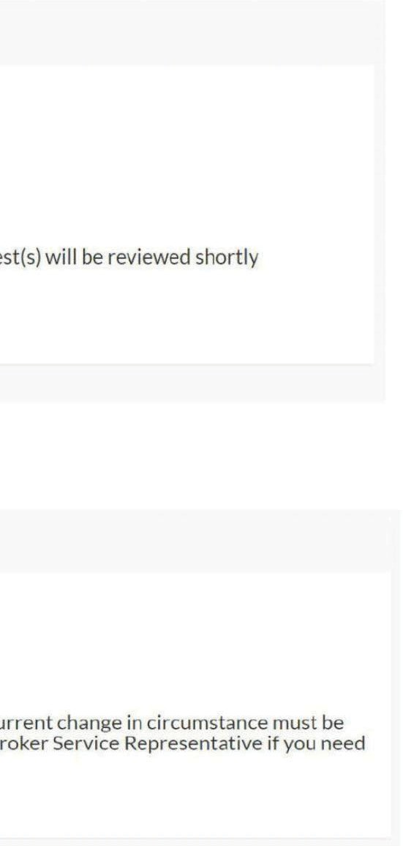

Change in Circumstance
CIC confirmation
Multiple CIC requests in process is not allowed. CIC request must be fulfilled before a new CIC request be generated.
Contact your Account Manager if a subsequent change is required.

Slide 35
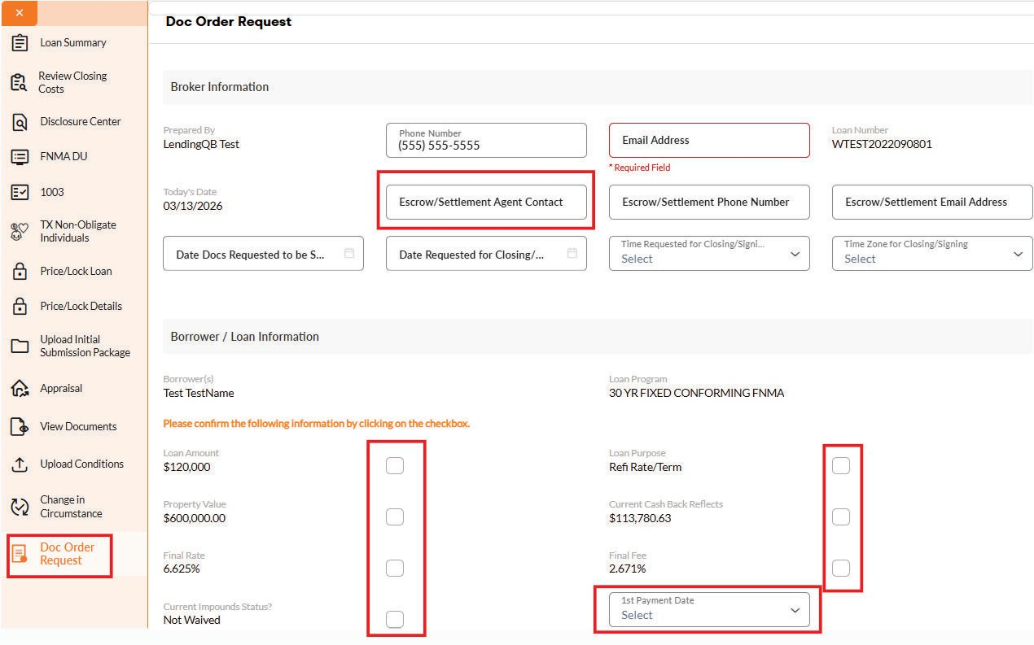
Doc Order Request
BLU will require the user to complete required fields for closing docs contact and email delivery.
Enter Individual name of settlement agent
Verification of loan specifics:
Loan amount
Interest rate and fee
Impounds
Loan purpose
1st Payment Date
If changes are required, the user can exit the screen and request a change in circumstance to be processed.

Slide 36
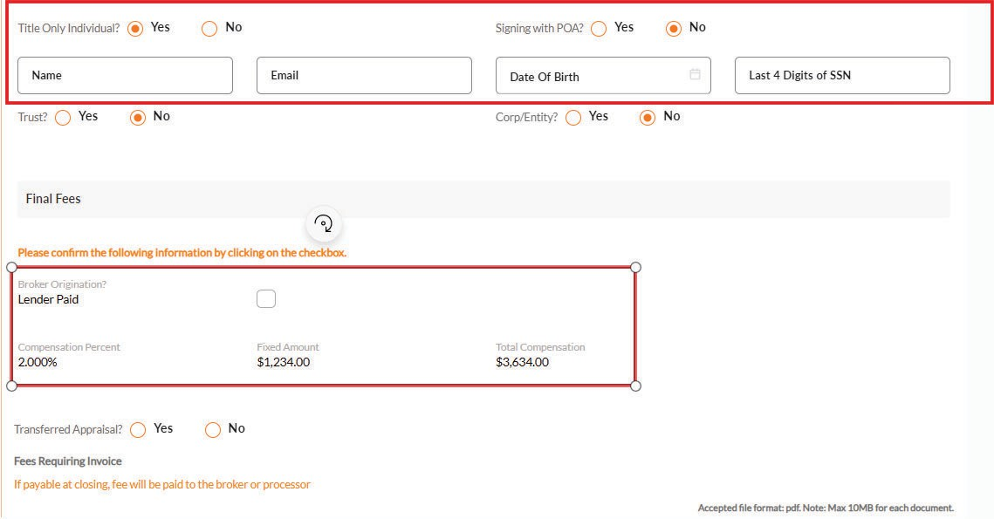
Doc Order Request
Complete all sections of the form.
Title Only Individuals
Toggles which to indicate
If yes, then additional information will need to be entered
POA & Trust Indicators
Yes or No must be indicated
Broker Origination
Verification of broker compensation.

Slide 37
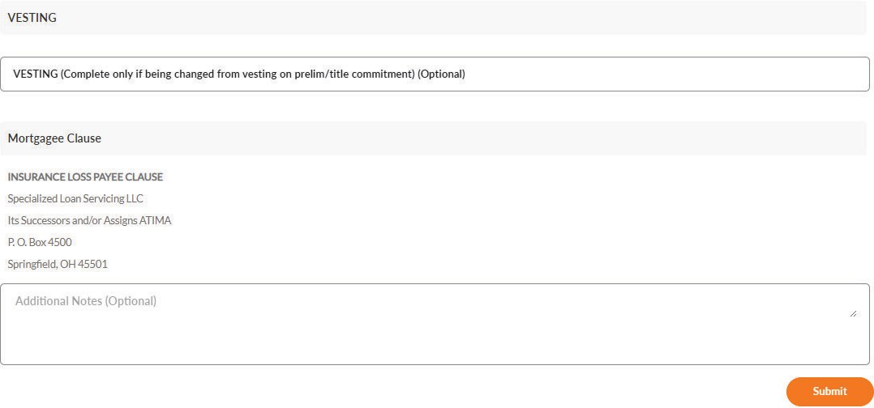
Doc Order Request
Vesting
If the loan purpose is purchase, user will be required to complete the vesting section.
Additional Notes
Submit
Upon submit, doc request document will be generated and uploaded automatically to the loan file.
Copy of the document will be made available in the ”view documents” section

Slide 38
Reimporting MISMO 3.4 Loan File
Based on certain restrictions, BLU will allow the user to reimport their 3.4 MISMO loan file to update the loan data without having to restart the loan creation process.

Slide 39
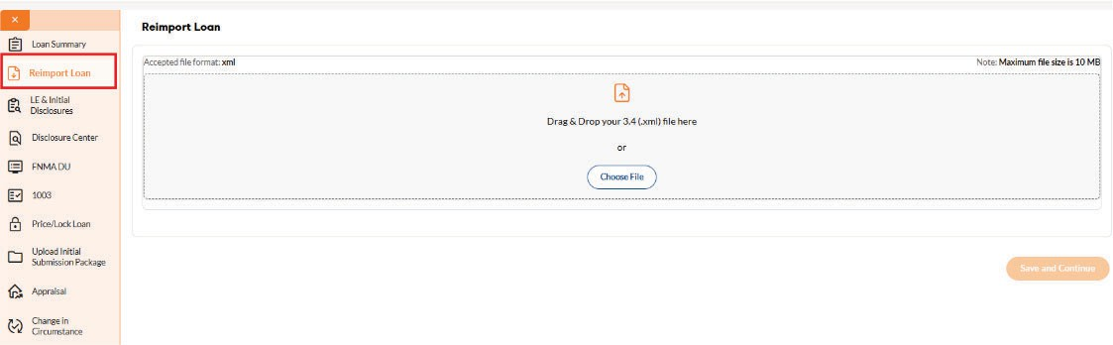
Reimporting MISMO 3.4 Loan File
The user may import the loan into BLU to update the loan information under the following conditions:
Loan status is ”Loan Open” or ”Registered”
The interest rate is NOT locked
Initial disclosures have not been sent to the borrower
If any of these conditions above is not true, the the user will not be able to reimport the file.

Slide 40
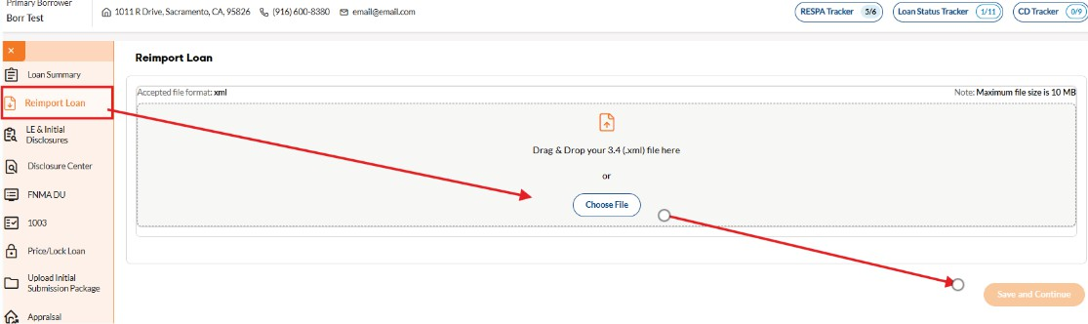
Reimporting MISMO 3.4 Loan File
Upload a new 3.4 MISMO File
Reimporting the file will walk the user through: Credit Score, REO & Liability Linking, Itemized Fees, Address Validation

Slide 41
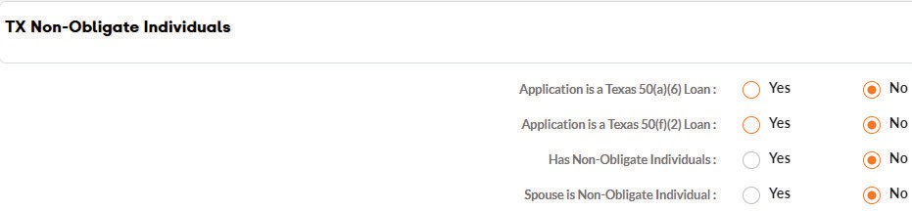
Texas Cash Out50(a)(6) & 50(f)(2)
During the loan creation, BLU will detect if the loan is setup for a Texas Cash out 50(a)(6) or 50(f)(2)
If applicable, BLU will require the user input the non-obligate individual(s) information to generate the Texas 12-day notice disclosure.
The information captured will allow Newfi to send the required disclosures to the non-obligate individual.

Slide 42
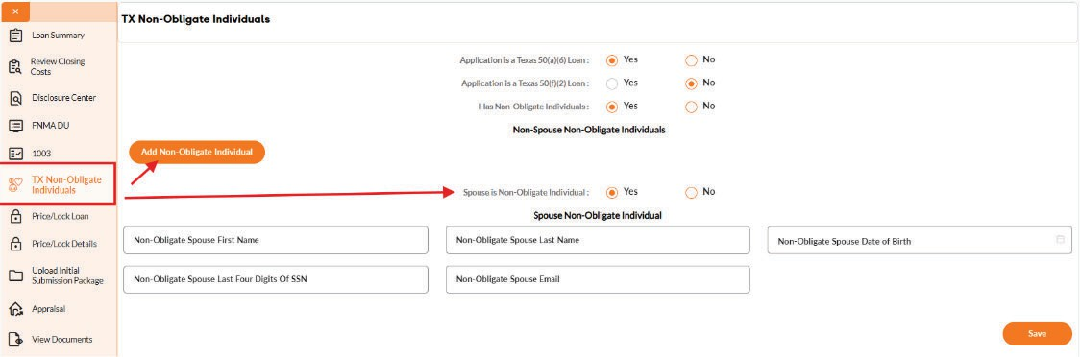
Texas Cash Out50(a)(6) & 50(f)(2)
After the loan is created in BLU, users will have an opportunity to update to add additional non-obligate individual(s) as necessary.
Click the “TX NON-OBLIGATE INDIVIDUALS” link from the menu options.
The information captured on this screen will be used to send the 12-Day disclosure.

